Slide 1
EIR Accessibility in Texas Procurement
DIR Connect
May, 2016

Slide 2
Electronic and Information Resources (EIR) Accessibility Basics
EIR accessibility means that people with disabilities can perceive, understand, navigate, and interact with the electronic information resources. It addresses all conditions that affect access to EIR including visual, auditory, physical, speech, cognitive, and neurological disabilities.
  Making EIR accessible allows people with disabilities to participate equally in the economic and social life of Texas. It also benefits others, including older people with changing abilities caused by aging

Slide 3
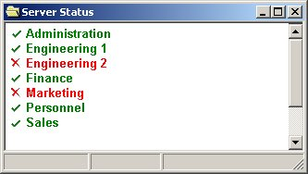
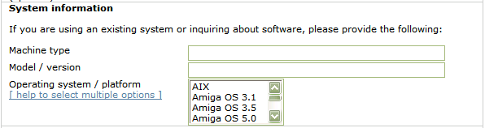
Understanding Disabilities
Blind users access software applications and the Web using a screen reader and the keyboard.
Low vision users need sizable fonts and contrast settings.
Users with limited use of arms and hands need keyboard accessibility features and alternative input methods.
Font size
Larger font size
Even larger
font size
Contrast
Poor
contrast
Contrast
Good
contrast
Alternative input hardware devices
Font size & contrast
“Machine type. Edit.
Model slash version. Edit.
Help to select multiple options. Link.
Operating system slash platform. Listbox. Not selected AIX. 1 of 30.”
Joy Sticks
Keyboards
Deaf users need alternatives for audio content (captioning); the hard of hearing need the ability to increase volume.
Switches
Mouth Sticks
Color-blind users need more than color differences.
Key Types | OS Keyboard Accessibility Features
Mouse Keys | Arrow keys control mouse pointer
Sticky Keys | [Ctrl] then [F] activates [Ctrl-F] shortcut
Slow Keys | Ignore short keystrokes
Repeat Keys | Turn off keystroke repeat Adjust delay before repeat begins Adjust delay between repeats

Slide 4



IT Accessibility Regulations
There are IT accessibility laws and regulations in
Various countries around the world
US federal procurement regulations (Section 508)
Many US states
Most cite accessibility technical standards
Texas statutes and rules
Apply to all Texas state agencies and institutions of higher education
  Texas Government Code 2054 Subchapter M
  Texas Administrative Codes
    1 TAC 206: State Websites
    1 TAC 213: Electronic & Information Resources
  1. US Section 508 is in the final stages of refresh; WCAG2.0 AA will be its new technical standard
  2. DOJ rules on web accessibility for Title II and III entities in progress (new SANPRM 4/28/16)

Slide 5

Scenario: Online Recruiting
Agency X just completed the procurement and deployment of a large new web application for recruiting new employees and managing job candidates.
Software Company A developed the product. Both Agency X and Company A’s studies indicated that the new system would offer significant advantages in cost savings, productivity, and candidate quality over the previous, mostly manual processes.
Enter job applicant “Susan”….

Slide 6

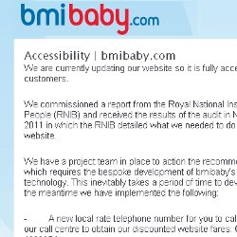


















Accessibility-related Complaints / Legal Inquiries on the Rise
Mar 25, 2016

Slide 7

The Procurement Dependency
Vendor sourced IT products / services make up the majority of state IT
Most products / services do not meet accessibility technical standards
There will be high dependency on procured IT for the foreseeable future
All states, federal agencies, and the private sector experience this problem
7

Slide 8
EIR Accessibility in DIR’s Cooperative Contracts
DIR’s role
Ensure that
  EIR accessibility language and documentation requirements are integrated into RFO templates and final contracts
  Accessibility documentation is included in vendor submissions and reviewed in the RFO process
    Voluntary Product Accessibility Templates (VPATs)
    Policy Driven Adoption for Accessibility (PDAA ) Vendor Self Assessment
    Other as specified
  Accessibility documentation (VPATs) are available from the vendor’s DIR contract web page (once awarded)
Notes:
8

Slide 9
EIR Accessibility in DIR’s Cooperative Contracts(Cont.)
Procuring agency’s role
Ensure that agencies understand their responsibilities when using DIR Contracts
  Boilerplate language in “Contract Overview” section of every DIR contract page:
Obtaining documentation from vendors that supports the levels of accessibility claimed in VPATs or development services
Perform assessments as needed on the accessibility of products and services being procured PRIOR to procurement
File exceptions through their agency exceptions processes for non compliant products / services
Electronic and Information Resources (EIR) Accessibility
Information regarding Electronic and Information Resources (EIR) accessibility of this vendor’s offerings is included in the contract. Agencies purchasing products or services are responsible for complying with Texas EIR Accessibility statute and rules, as defined in TGC 2054 Subchapter M, 1TAC 206, and 1 TAC 213. For additional information, visit the Vendor Website or contact the vendor directly.
Notes:
9

Slide 10
Where Accessibility in Procurement Applies
EIR Procurement Type | Examples | EIR Accessibility Required
Direct use of EIR | The procurement of software used on agency public facing websites. software used by employees in the performance of their work. copy machines that will be used by agency employees. services to develop websites used by employees or the public. externally hosted websites or services used by the public or agency employees. Hardware or software with a user interface used by the public or Texas employee(s) | Yes
Direct but insignificant use of EIR | The procurement of specific software with no administrative or public user interface. (Service personnel use) | Maybe
Indirect use of EIR | The procurement of human resources services delivered through a website or telephone system. wellness services that may be delivered through social media such as Facebook pages or through Web-based multimedia or videos. training or technical support that may be delivered through electronic handbooks, forms, or through a Web-based or telephone information system. transaction services that may require the public to interact with EIR through interoperable controls, video screens, menus, or websites as in the use of a debit card reader or ticket kiosk. | Maybe
Non-EIR | Purchase of food, office supplies, and other staples | No
Notes:
10

Slide 11
How Do We Know What’s Accessible?
How do we measure accessibility?
  Commercial off the Shelf (COTS) products
    Accessibility levels documented in vendor published Voluntary Product Accessibility Templates (VPATs)
      Accuracy varies wildly from vendor to vendor, product to product
  Development services and related deliverables
    VPATs do not apply so other forms of documentation / assessment are required.
How can the accuracy of vendor accessibility information be ascertained?
To what degree are vendors are committed to future improvements in the accessibility of their products / services?

Slide 12
What is a VPAT?
An industry standardized, vendor generated, product specific report document used to evaluate EIR accessibility as measured against the technical provisions in US Section 508
Applies to commercial off the shelf (COTS) offerings only
Helps procurement and contracting officials make preliminary assessments of the degree of accessibility compliance in a vendor’s COTS EIR offerings
Allows procurement staff to evaluate accessibility compliance consistently across multiple vendors
A vendor's familiarity with the VPAT can be an indicator of the vendor’s level of understanding of EIR accessibility.
Notes:
12

Slide 13
Analyzing the VPAT
Must not be blank
Main Sections categorized by EIR type
Degree of compliance
Date:
Name of Product:
Contact for more Information (name/phone/email):
Supporting or exceptions information
Summary Table VPAT™ Voluntary Product Accessibility Template®
Criteria | Supporting Features | Remarks and explanations
Section 1194.21 Software Applications and Operating Systems
Section 1194.22 Web-based Intranet and Internet Information and Applications
Section 1194.23 Telecommunications Products
Section 1194.24 Video and Multimedia Products
Section 1194.25 Self-Contained, Closed Products
Section 1194.26 Desktop and Portable Computers
Section 1194.31 Functional Performance Criteria
Section 1194.41 Information, Documentation, and Support
One or more of these sections 1194.21 - .1194.26 should be completed (product dependent)
Sections always completed 1194.31 and 1194.41
Notes:
13

Slide 14
Analyzing a VPAT
Engage your Accessibility Coordinator
Be skeptical! VPATs may contain false, inaccurate, or misleading information.
  Red Flags
    Vendor asks “What is a VPAT?”
    No VPAT available
    Global, nonspecific accessibility statements
    Incomplete section or the use of N/A (not applicable) in areas of the VPAT criteria that are known to be applicable
    VPATs created by a reseller and not the offering manufacturer
    No information in the “Remarks” column
    “Supports” for all responses in the “Supporting Features” column
Notes:
14

Slide 15
Questions for Vendors and Organizations on ICT Accessibility
Questions | Policy / Culture | Offerings
Can you provide a copy of, or link to the organization’s ICT Accessibility Policy? | Yes | Yes
Can you provide information regarding the organizational structure of the organization’s ICT Accessibility Program? (where the function(s) is located within the organization, title of program head, centralized vs. distributed personnel, etc.) | Yes
Can you provide documentation on key business processes that have ICT accessibility integrated into them? (Examples: product development, procurement, HR, etc.) | Yes
Can you provide documentation on the integration of ICT accessibility activities into your development processes? | Yes | Yes
Can you describe the skills and training resources that your organization uses (internal or third party) to develop and produce accessible ICT offerings | Yes | Yes
What development tools, test tools, and methods does your organization use to produce accessible ICT offerings and its associated documentation (VPATs, etc.)? |  | Yes
Can you provide examples of typical test cases used to validate accessibility and how test results are documented? |  | Yes
Does your organizations have corrective actions process(es) or system(s) for documenting, tracking, and resolving accessibility issues / defects? | Yes | Yes
Are there work arounds or alternate methods for ICT products that are not compliant with accessibility technical standards. (example: 24hour / 7day/week toll free phone support number): | Yes | Yes
Can you provide links to websites or other examples of ICT work that your organization has produced that meet accessibility technical standards such as US Section 508, or WCAG 2.0 AA |  | Yes

Slide 16
Exception Process
If the selected EIR procurement does not comply with Texas EIR Accessibility requirements, an approved exception form must be completed by the procuring agency before the contract is awarded.
The EIR Accessibility Exception
  Does not eliminate risks associated with non-accessible EIR
  Does not eliminate the responsibility to provide an accessible solution
  Must provide solid justification for purchasing non-accessible EIR:
    Non-availability of accessible products
    Fundamental alteration required to make accessible
    Cost prohibitive to make EIR accessible
    Etc.
  Must include an “alternate means of access.”
    1-800 number
    Deskside assist by manager
    Other
  Must be signed by the agency head
A generic EIR Accessibility Exception Request Form can be accessed from DIR’s EIR Accessibility Center Website

Slide 17
Assistance Tools
DIR assistance tools for EIR accessibility procurement decisions

Slide 18
Vendor VPAT Completion Instructions

Slide 19
§213.18 / §213.38 Accessibility in Procurements
Includes new provisions to improve procurement in selecting products and services
  Requires evidence of vendors’ ability to produce accessible EIR products and services for VPATs and for non COTS offerings
    “….such evidence may include, but is not limited to, a vendor’s internal accessibility policy documents, contractual warranties for accessibility, accessibility testing documents, and examples of prior work results.”

Slide 20
Vendor EIR Accessibility Development Services Info Request

Slide 21
PDAA Vendor Self Assessment Tool
Questionnaire for vendors regarding the vendor’s ICT accessibility policy and progress against the PDAA Core Criteria.
  Score generated from responses
  based on the PDAA Maturity Model
Includes FAQs for vendors and procurement organizations.
(Open tool)

Slide 22
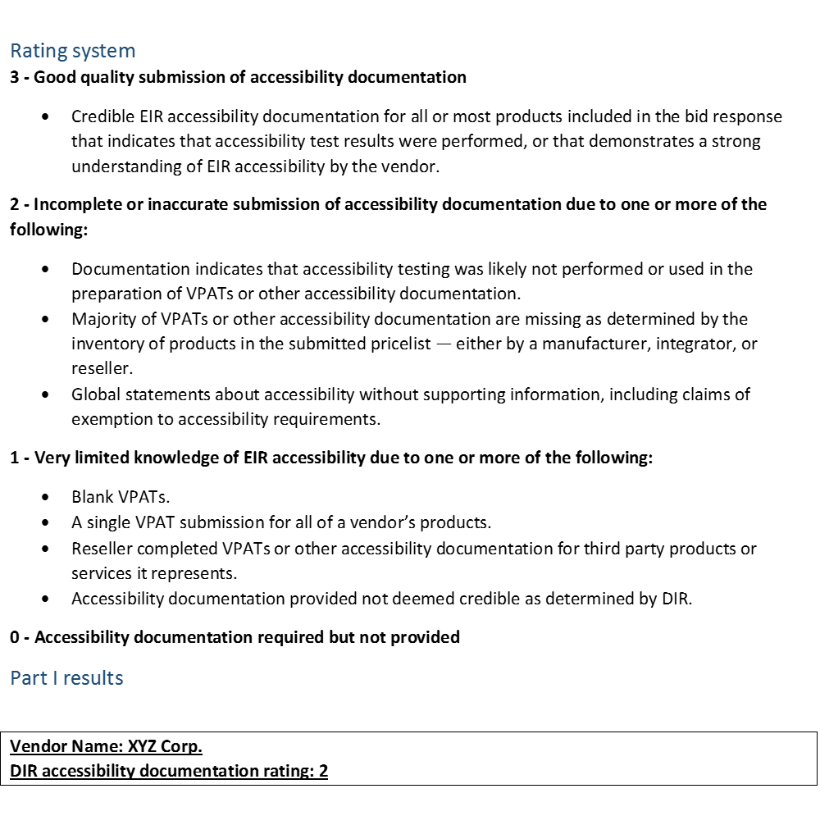
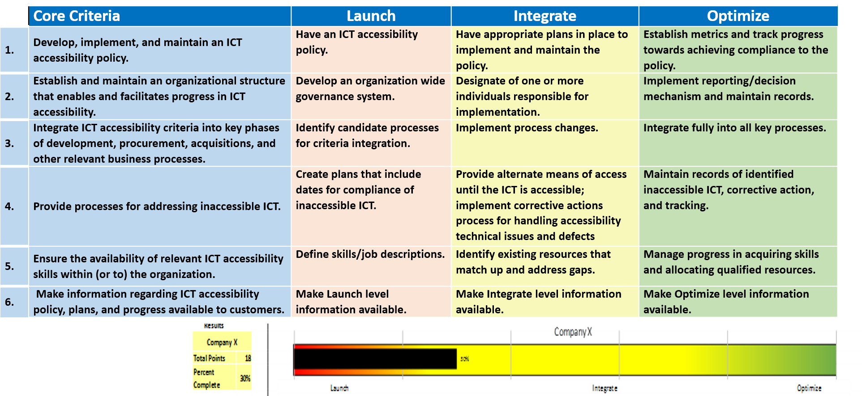
Vendor EIR Accessibility Review Report
DIR EIR Accessibility Review reports from cooperative contracts RFOs
Section 1: VPAT submission quality review rating
  Section 2: Policy Driven Adoption for Accessibility (PDAA) Vendor Self Assessment

Slide 23
PDAA Additional Information Request

Slide 24
Summary of assistance tools for EIR accessibility procurement decisions
New provisions §213.18 / §213.38 Accessibility in Procurements to improve procurement in selecting products and services
    Requires evidence of vendors’ ability to produce accessible EIR products and services beyond VPATs and for non COTS offerings
      “….such evidence may include, but is not limited to, a vendor’s internal accessibility policy documents, contractual warranties for accessibility, accessibility testing documents, and examples of prior work results.
Instructions to vendors on how to complete a VPAT
  Can be used by agency procurement to help ascertain if the VPATs are accurately and properly completed
IT Development Services Vendor EIR Accessibility Information Request Form
DIR EIR Accessibility Review reports from cooperative contracts RFOs
  VPAT submission quality review rating
  Policy Driven Adoption for Accessibility (PDAA) Vendor Self Assessment
PDAA Vendor Additional Information Request form

Slide 25
DIR Resources for EIR Accessibility in Procurement
EIR Accessibility Procurement Information and forms:
http://dir.texas.gov/View-Resources/Pages/Content.aspx?id=39#Procurement
Vendor Accessibility Information Request
http://dir.texas.gov/View-Resources/Pages/Content.aspx?id=48
jeff.kline@dir.texas.gov

