Slide 1
Framing Companies into Accessible Operations: Policy Driven Adoption for Accessibility (PDAA)
Sarah Bourne
Director of IT Accessibility, Massachusetts Office of Information Technology
Jeff Kline
Statewide IT Accessibility Coordinator, Texas Department of Information Resources
Jay Wyant
Chief Information Accessibility Officer, Minnesota IT Central
March, 2015
1

Slide 2
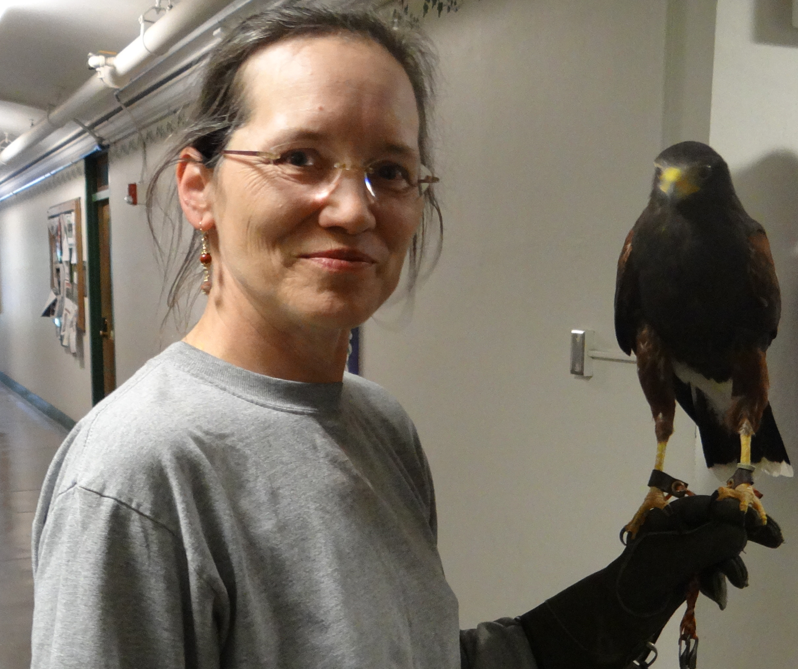
Regards from Massachusetts!

Slide 3

The Procurement Dependency
Vendor sourced IT products and services make up the majority of government IT
  Most products and services do not meet accessibility technical standards (US 508, WCAG 2.0 AA)
  There will be continued high dependency on procured IT for the foreseeable future
3

Slide 4
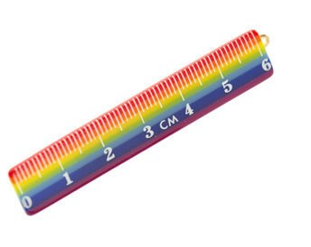
The Accountability Issue
How do we measure accessibility?
  VPATS only apply to goods and customized products
    Accuracy depends on vendors’ expertise
  Does not cover professional/technical services and related deliverables
  How to choose between competing products with low accessibility?
  How to measure vendor commitment to future improvements?

Slide 5

Current IT Accessibility Models Not Working Well
Recent US government reports…
Source | Results
National Disability Policy Progress Report - 2012 | Rarely mentions ICT accessibility
Section 508 Report to the President and Congress: Accessibility of Federal Electronic and Information Technology - 2012 | Finds that less than 50% of agency components incorporated specific applicable Section 508 Accessibility Standards as requirements in each procurement solicitation… Little to no validation against Section 508 criteria performed on procured products
US E-Government Website Quality Report - 2012 | The accessibility benchmark shows that two-thirds of federal sites achieved a moderate level of compliance federal sites 28% of sites in the study achieved the lowest compliance band. Automated testing only; tool(s) not defined
The situation in Europe and the rest of the world isn’t any better…
Source | Results
European Commission research behind Proposed Directive on Accessibility of Public Sector websites (Dec 2012) | Only one-third of Europe’s 761,000 public-sector and government websites are accessible
G3ict: CRPD 2012 ICT Accessibility Progress Report | Indicates significant deficits to set in place a foundation to promote ICT accessibility

Slide 6

IT accessibility today is a governance problem
Pushing technical specifications/standards has not been an adequate adoption driver
Technical standards are execution criteria not governance criteria
Nothing in today’s technical standards address governance
No silver bullet technology solutions on the horizon
Challenge
What can help ICT vendors better meet technical standards and government regulations for ICT accessibility?

Slide 7


Public sector governance model trends
President’s Office of Management and Budget (OMB)
“Strategic Plan for Improving Management of Section 508 of the Rehabilitation Act” – Jan. 2013
  Federal agencies must have accessibility statement (policy) on internet / intranet websites
  Template for reporting baseline compliance by agencies to OMB / others
  Naming of a 508 coordinator for each agency
  Delivery of learning modules by the GSA
Ontario: Accessibility for Ontarians with Disabilities Act (AODA)
Requires: Public and private entities with over 20 employees operating in Ontario to
  Establish accessibility policies
  Establish, implement, maintain and document accessibility plans
  File Accessibility Compliance Reports online
  Incorporate accessibility criteria and features into procurement
  Timetables for required compliance
  Fine schedules

Slide 8
Governance included in settlements
HR Block & PeaPod
Appoint a skilled web accessibility coordinator who will report directly to an executive
Adopt a web accessibility policy
Mandatory accessibility training for web content personnel
Youngstown State University & University of Montana
Develop web accessibility policy and an implementation and remediation plan
Mandatory accessibility training for web content personnel
Put in place mechanisms to ensure that the sites continue to be accessible.
Notes:
Note also settlements in higher ed and other government entities.

Slide 9
Time for:
Policy Driven Adoption for Accessibility (PDAA)
The integration of IT accessibility governance into organization policies in a way that enables them to drive themselves to improve accessibility adoption.
    Makes IT accessibility difficult to ignore
    Not prescriptive, tells what, not how
    Governed through non-technical methods
    Accelerates marketplace innovations

Slide 10
How does PDAA implementation help vendors?
Organizations with fully implemented PDAA can have:
Competitive advantage in public sector solicitations
Improved Search Engine Optimization (SEO)
Increased market share through expansion of customer base
Increased brand equity through social responsibility
Improved ability to hire and retain people with disabilities
Risk mitigation if ADA complaints / litigation arises
  In ICT accessibility, E for Effort counts!

Slide 11

NASCIO PDAA Workgroup: 2013 - Present
  Goal: Create working procurement model
  Representation from 10 states and 1 federal government agency
  Championed by Texas State CIO
  Objectives
    Develop a common set of PDAA criteria
      Include supporting deliverables for vendor self guidance and progress measurement
    Package as model for adoption by states

Slide 12
PDAA Participants
State | Title
Arkansas | Chief Technology Officer / Director of Arkansas Department of Information Systems
Arkansas | Chief Enterprise Architect / Arkansas Department of Information Systems
California | Deputy Director, Statewide Technology Procurement / California Department of Technology
California | Chief Purchasing Manager, Statewide Technology Procurement / California Department of Technology
Federal | US Consumer Financial Protection Bureau / Senior Procurement Executive
Federal | Outreach Specialist / US Consumer Financial Protection Bureau
Kansas | Chief Information Security Officer / Office of Information Technology Services
Maine | Associate Chief Information Officer / Office of Information Technology
Massachusetts | Director of Assistive Technology / Mass. Information Technology Division
Minnesota | Chief Information Accessibility Officer / Minnesota IT Services
Puerto Rico | Vice President & Chief Information Officer / Information Systems Government Development Bank for Puerto Rico
Texas | Director, Technology Sourcing Office / Texas Department of Information Resources
Texas | Director, Technology Planning, Policy & Governance / Texas Department of Information Resources
Texas | Statewide EIR Accessibility Coordinator / Texas Department of Information Resources
Texas | Sr. Project Manager / Texas Department of Information Resources
Texas | Director, Texas Procurement and Support Services (TPASS) / Texas Comptroller of Public Accounts
Utah | Chief Technology Officer / Department of Technology Services
Utah | Executive Director and Chief Information Officer / Department of Technology Services
Virginia | Strategic Sourcing Manager / Virginia Information Technologies Agency (VITA)
Virginia | Web Development and Production Support Manager / Virginia Information Technologies Agency
Virginia | Enterprise Architect & Agency Records Officer / Policy, Practice & Architecture / Virginia Information Technologies Agency
Virginia | Disability Agencies Web Lead / Department of Rehabilitative Services
Virginia | Manager, IT Investment Management Office / Virginia Information Technologies Agency
Virginia | Chief Operations Officer / Virginia Department for Aging and Rehabilitative Services
Virginia | Application Services Manager/ Enterprise Solutions and Governance / Virginia Information Technologies Agency

Slide 13
PDAA Deliverables
Deliverables completed and reviewed by workgroup members:
PDAA Core Criteria
PDAA Maturity Model
Self-assessment form/questionnaire for vendors
PDAA FAQs
Generic vendor implementation timeline
List of resources

Slide 14
PDAA Core Criteria for Vendors
Develop, implement, and maintain an ICT accessibility policy.
Establish and maintain an organizational structure that enables and facilitates progress in ICT accessibility.
Integrate ICT accessibility criteria into key phases of development, procurement, acquisitions, and other relevant business processes.
Provide a process for addressing inaccessible ICT.
Ensure the availability of relevant ICT accessibility skills and other resources within (or to) the organization.
Make information regarding ICT accessibility policy, plans, and progress available to customers.

Slide 15
PDAA Core Criteria #1
 | Core Criteria | Launch | Integrate | Optimize
1. | Develop, implement, and maintain an ICT accessibility policy. | Have an ICT accessibility policy. | Have appropriate plans in place to implement and maintain the policy. | Establish metrics and track progress towards achieving compliance to the policy.
Develop, implement, and maintain an ICT accessibility policy.
Creates a foundation on which accessibility programs and initiatives can be built.
Ensures continuity of accessibility efforts by supporting strategic rather than tactical efforts.
Allows people in different roles across the organization to understand their responsibilities.

Slide 16
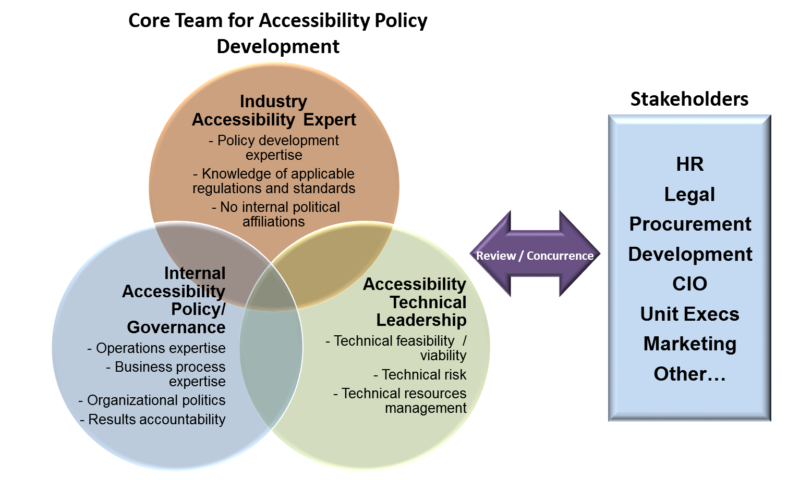
Developing an organization-wide
IT accessibility policy

Slide 17
PDAA Core Criteria #2
 | Core Criteria | Launch | Integrate | Optimize
2. | Establish and maintain an organizational structure that enables and facilitates progress in ICT accessibility. | Develop an organization wide governance system. | Designate of one or more individuals responsible for implementation. | Implement reporting/decision mechanism and maintain records.
Establish and maintain an organizational structure that enables and facilitates progress in ICT accessibility.
Ensures that ICT accessibility roles are identified and positioned within the organization for greatest impact
Defines responsibilities across the organization, including the designation of an executive sponsor.

Slide 18
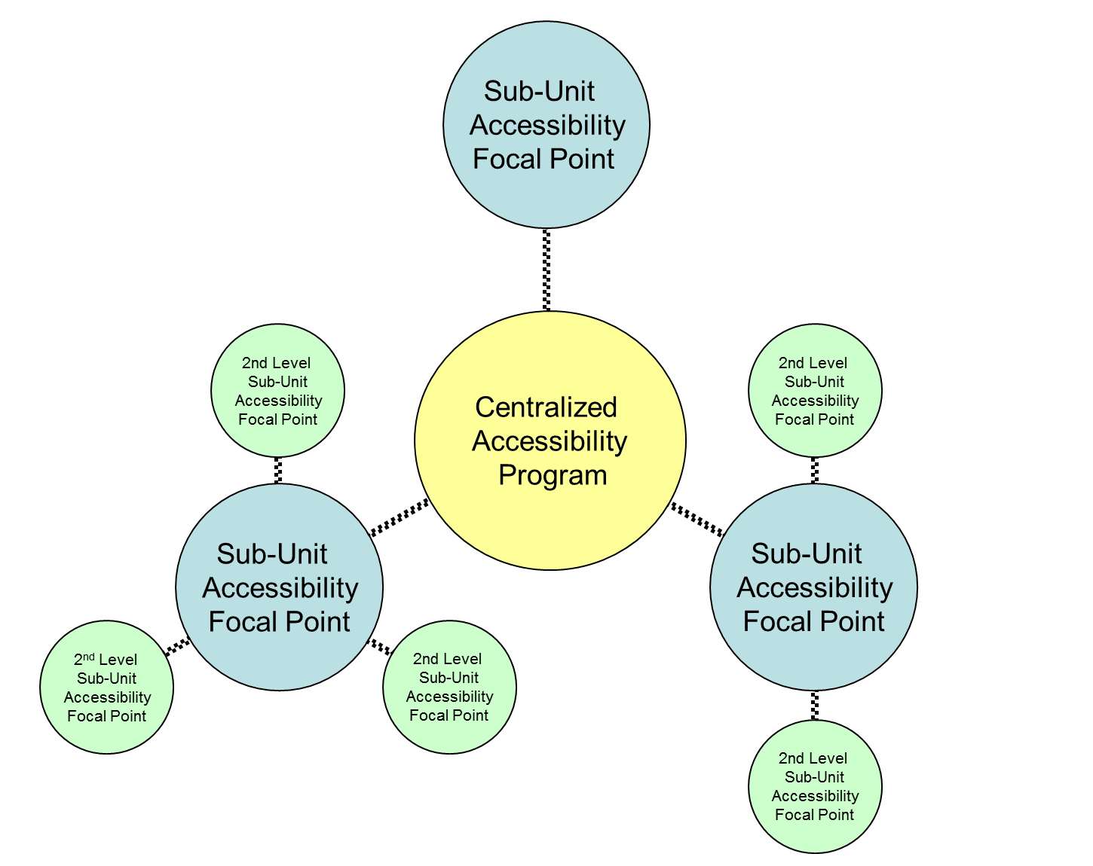
Organizing accessibility
Senior manager “executive sponsor”
“Neutral” organizational placement
  Analysis of implications based reporting organization
Centralized accessibility function
  Policy and governance
  Technical consulting
  Business development / sales support
  Project office
  Other?
Sub-Unit focal points / coordinators

Slide 19
PDAA Core Criteria #3
 | Core Criteria | Launch | Integrate | Optimize
3. | Integrate ICT accessibility criteria into key phases of development, procurement, acquisitions, and other relevant business processes. | Identify candidate processes for criteria integration. | Implement process changes. | Integrate fully into all key processes.
Integrate ICT accessibility criteria into key phases of development, procurement, acquisitions, and other relevant business processes.
Ensures that ICT accessibility is implemented in a consistent, repeatable fashion
Removes dependency on specific individuals who “carry the torch” for specific events or projects where ICT accessibility is required.

Slide 20
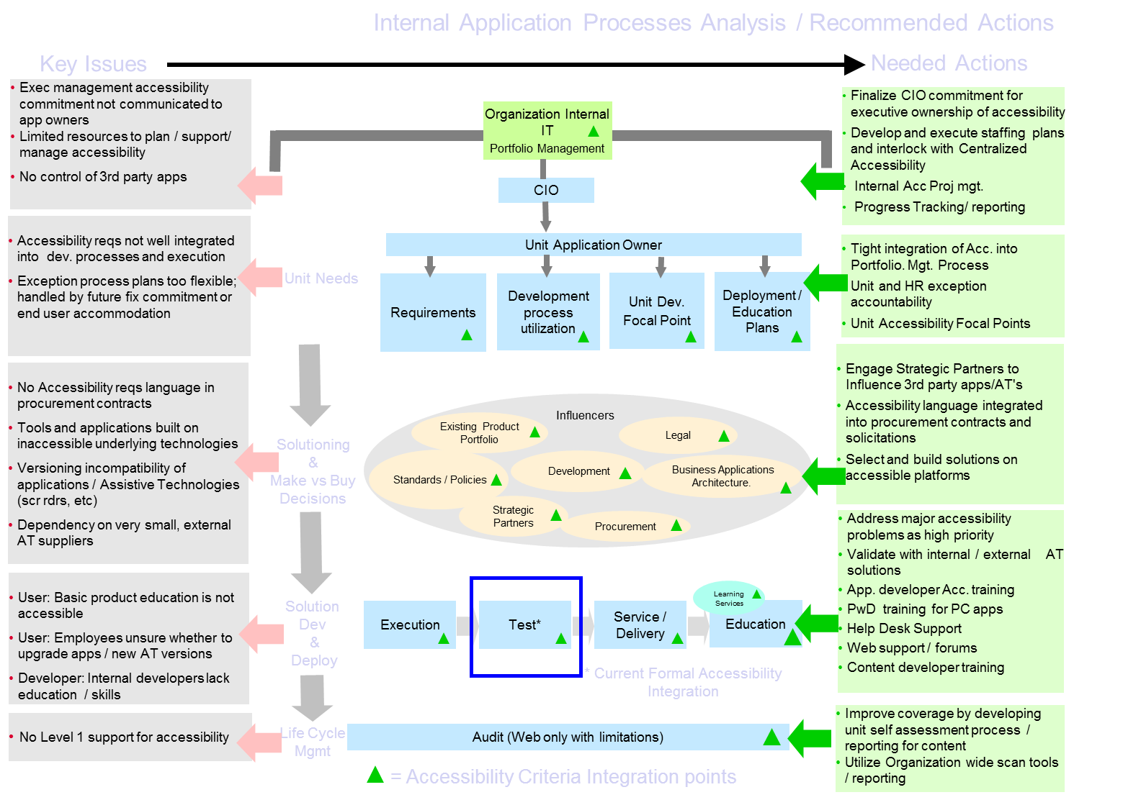
Integrate Accessibility into Key Business Processes: Analysis Example

Slide 21
PDAA Core Criteria #4
Provide a process for addressing inaccessible ICT.
Ensures that plans are developed to address ICT accessibility issues once identified.
Provides a mechanism to implement accommodations until the ICT is accessible
 | Core Criteria | Launch | Integrate | Optimize
4. | Provide processes for addressing inaccessible ICT. | Create plans that include dates for compliance of inaccessible ICT. | Provide alternate means of access until the ICT is accessible; implement corrective actions process for handling accessibility technical issues and defects | Maintain records of identified inaccessible ICT, corrective action, and tracking.

Slide 22
PDAA Core Criteria #4: Examples
  Examples of addressing inaccessible ICT
  Corrective actions identification and tracking in product development life cycle
  Procurement of future, more accessible ICT
  Mechanism for providing alternate means of access until the ICT is made accessible or replaced
    1-800 numbers, etc.

Slide 23
PDAA Core Criteria #5
Ensure the availability of relevant ICT accessibility skills and other resources within (or to) the organization.
Identify necessary knowledge/skills and existing gaps
Provide training opportunities
Include accessibility skills in hiring criteria
Track and manage gaps
 | Core Criteria | Launch | Integrate | Optimize
5. | Ensure the availability of relevant ICT accessibility skills within (or to) the organization. | Define skills/job descriptions. | Identify existing resources that match up and address gaps. | Manage progress in acquiring skills and allocating qualified resources.

Slide 24
Identify Skill Gaps and Build “Role Based” Accessibility Training Plans
Course Level | Course Title | All Staff | Web Content Producers | Web & Application Testers | Web Application Developers | Procurement Staff | Contract Writers | Contract Compliance | Project Managers
Fundamentals | Introduction to Accessibility (Self) | Required | Required | Required | Required | Required | Required | Required | Required
Fundamentals | Office Documents (Internal) | Optional | Required | Optional | Optional | Required | Required | Optional | Required
Fundamentals | PDF (Internal) | Required / Optional* | Required | Optional | Optional | Required / Optional* | Required / Optional* | Required / Optional* | Required / Optional*
Fundamentals | HTML (Internal or External) |  | Required | Required | Required
Fundamentals | HTML Forms (Internal or External) |  | Required | Optional | Required
Fundamentals | Testing & Tools (Internal or External) |  | Required | Required | Required
Fundamentals | CSS (Internal or External) |  | Optional | Optional | Required
Fundamentals | Javascript (Internal or External) |  | Optional | Optional | Required
Advanced | Sharepoint / Dreamweaver (Internal or External) |  |  |  | Required / Optional*
Advanced | ASP / ASP.Net (Internal or External) |  |  |  | Required / Optional*
Advanced | Java / JSP (Internal or External) |  |  |  | Required / Optional*
Advanced | Web 2.0 Technologies (Internal or External) |  |  |  | Required / Optional*
Specialized | Accessibility Law, and its Impacts |  |  |  |  | Required | Required | Required | Required
Specialized | Accessibility in Contract Solicitations |  |  |  |  | Required | Required | Required | Required
Specialized | Understanding/validating Vendor IT accessibility |  |  |  |  | Required | Required | Required | Required
* As needed based on assignment.

Slide 25
PDAA Core Criteria #6
 | Core Criteria | Launch | Integrate | Optimize
6. | Make information regarding ICT accessibility policy, plans, and progress available to customers. | Make Launch level information available. | Make Integrate level information available. | Make Optimize level information available.
Make information regarding ICT accessibility policy, plans, and progress available to customers.
Encourages formalized tracking and management of PDAA initiatives
Provides customers with information for gauging organizational abilities and progress

Slide 26

PDAA Maturity Model
 | Core Criteria | Launch | Integrate | Optimize
1. | Develop, implement, and maintain an ICT accessibility policy. | Have an ICT accessibility policy. | Have appropriate plans in place to implement and maintain the policy. | Establish metrics and track progress towards achieving compliance to the policy.
2. | Establish and maintain an organizational structure that enables and facilitates progress in ICT accessibility. | Develop an organization wide governance system. | Designate of one or more individuals responsible for implementation. | Implement reporting/decision mechanism and maintain records.
3. | Integrate ICT accessibility criteria into key phases of development, procurement, acquisitions, and other relevant business processes. | Identify candidate processes for criteria integration. | Implement process changes. | Integrate fully into all key processes.
4. | Provide processes for addressing inaccessible ICT. | Create plans that include dates for compliance of inaccessible ICT. | Provide alternate means of access until the ICT is accessible; implement corrective actions process for handling accessibility technical issues and defects | Maintain records of identified inaccessible ICT, corrective action, and tracking.
5. | Ensure the availability of relevant ICT accessibility skills within (or to) the organization. | Define skills/job descriptions. | Identify existing resources that match up and address gaps. | Manage progress in acquiring skills and allocating qualified resources.
6. | Make information regarding ICT accessibility policy, plans, and progress available to customers. | Make Launch level information available. | Make Integrate level information available. | Make Optimize level information available.

Slide 27
Generic Vendor Implementation Timeline
Criteria (begins when vendor is informed of PDAA) | 6mo | 12mo | 18mo | 24mo
1. Develop, implement, and maintain an ICT accessibility policy.
a. Have an ICT accessibility policy.
b. Have appropriate plans in place to implement and maintain the policy.
c. Establish metrics and track progress towards achieving compliance to the policy
2. Establish and maintain an organizational structure that enables and facilitates progress in ICT accessibility.
a. Develop an organization wide governance system.
b. Designate of one or more individuals responsible for implementation
c. Implement reporting/decision mechanism and maintain records.
3. Integrate ICT accessibility criteria into key phases of development, procurement, acquisitions, and other relevant business processes.
a. Identify candidate processes for criteria integration.
b. Implement process changes.
c. Integrate fully into all key processes.
4. Provide a process for addressing inaccessible ICT including:
a. a plan / date for compliance of an inaccessible ICT.
b. an alternate means of access until the ICT is accessible.
c. a corrective actions process for handling accessibility technical issues and defects.
5. Ensure the availability of relevant ICT accessibility skills within (or to) the organization.
a. Define skills/job descriptions.
b. Identify existing resources that match up and address gaps.
c. Manage progress in acquiring skills and allocating qualified resources.
6. Make information regarding ICT accessibility policy, plans, and progress available to customers.
a. Make Launch level information available.
b. Make Integrate level information available.
c. Make Optimize level information available.

Slide 28
PDAA Vendor Self Assessment Tool and FAQs
The PDAA Vendor Self-Assessment Tool (Open tool)
FAQs for vendors and procurement organizations.
Questionnaire for vendors regarding the vendor’s ICT accessibility policy and progress against the PDAA Core Criteria.
Results can be used by both:
  Procurement organizations
    Help assess a vendor’s ability to produce accessible offerings
    Gauge confidence in vendor’s VPAT or other accessibility documentation
    Track vendor progress and improvement in ICT accessibility initiatives
    Use as part of vendor selection decisions
  Vendors
    Guide the implementation of organization wide accessibility programs / initiatives
    Help achieve more accessible offerings over the long term

Slide 29
PDAA Vendor Self Assessment Tool Applicability
Assessment addresses different vendor types
Manufacturer
  Develops and sells its own ICT products / services
  Must also provide VPATs where appropriate
Service Provider
  Sells IT development services
Integrator
  Develops customer solutions using a combination of 3rd party and in-house products and services
  Must also provide VPATs where appropriate
Distributor or Reseller
  Does not develop or have its own products, but offers COTS 3rd party products
  Must also require and provide access to VPATs where appropriate

Slide 30
PDAA Reference Information
For both procurement organizations and vendors
Techcheck – On Line Assessment Tool developed by the Partnership on Employment and Accessible Technology (PEAT) and sponsored by the Office of Disability Employment Policy (ODEP), U.S. Department of Labor
W3C – Web Accessibility Initiative - Planning and Implementing Web Accessibility
British standard BS-8878 Web Accessibility Code of Practice - Accessibility business process integration
Strategic IT Accessibility: Enabling the Organization – Reference book on organizational accessibility enablement, strategy, and implementation
Digital Accessibility Maturity Model (DAMM) from SSB Bart Group - A Capability Maturity Model based framework to help digital accessibility programs measure their development against an objective yardstick
Accessibility Implementation Framework, Texas Department of Information Resources - A comprehensive framework and project plan to guide an organization’s IT accessibility program and initiatives

Slide 31

PDAA in Practice - Texas
Texas DIR initiated use of PDAA in August 2014
“Education IT Products and Services” request for offerings (RFO)
  Vendors required to complete assessment
  Results not scored as part of contract award criteria
  Responses recorded and compared to later responses in:
    Subsequent solicitations
    Contract renewals
Results planned to be available at customer requests
New RFOs using the PDAA tool
Link to DIR PDAA site

Slide 32
PDAA in Practice – Minnesota
PDAA pilot for feedback
PDAA materials posted on public website
Five vendors with current long-term contracts asked to complete self-evaluation and submit results
Use feedback from both administrative and vendor side to analyze model, determine next steps
Link to MN PDAA site

Slide 33
Next Steps
Increase adoption by member workgroup organizations and by state governments, federal agencies, and private sector organizations
Continue to socialize PDAA and obtain input from public and private sector accessibility communities
  NASCIO “Issue Brief” paper in process
Explore universal locations (website) for PDAA information repository hosting

Slide 34
Questions?
Thank you!
Sarah Bourne, State of Massachusetts
Jeff Kline, State of Texas
Jay Wyant, State of Minnesota

