Slide 1
DIR Next Gen
Capitol Complex Telephone System (CCTS)
Standard Product Catalog
Rev. 08222019

Slide 2

Table of Contents
Lobby, Cisco IP Phone 3905
2-Line, Cisco IP Phone 8811
5-Line, Cisco IP Phone 8841
Multi-Line, Cisco IP Phone 8851 with KEM
Video Phone, Cisco Unified Phone 8945
Conference Phone, Cisco Unified IP Conference Phone 8832
Analog Adapter, UC 2-Port Telephone Adapter
Jabber – Mobility, No Desk Phone
Jabber – Mobility
ACD Agent Enhanced
ACD Agent Premium
Agency Router, Cisco 2911 ISR
End Point Cost Summary

Slide 3
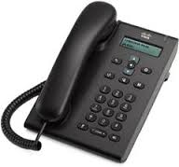
Lobby
3905 IP Phone
$14.98 per month
  Includes line, license, VM (if applicable) and device cost
Single button IP Phone with Call Waiting
Display
Speakerphone
Ethernet port for PC
Ideal for lobbies or general areas like a lunchroom, copy room, etc… that need very basic calling capabilities, similar to a single-line analog phone

Slide 4
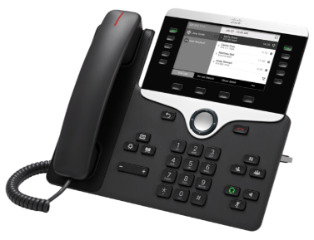
2-Line IP Phone
8811 IP Phone
$17.75 per month
  Includes line, license, VM (if applicable) and device cost
2-button phone with 5” 800x480 greyscale display
Call waiting on each line (manage multiple calls on a single button)
Standard and advanced calling features (Conference, transfer, forward calls, etc.)
Gigabit Ethernet port for PC
Full duplex speakerphone
TOC
Ideal for most employees and knowledge users, campus based or teleworkers, as users will have excellent voice quality with enhanced call handling features

Slide 5
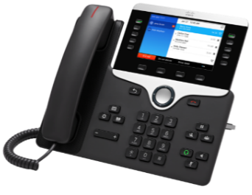
5-Line IP Phone
8841 IP Phone
$18.68 per month
  Includes line, license, VM (if applicable) and device cost
5-line button phone with 5” 800x480 color display
Call waiting on each line (manage multiple calls on a single button)
Standard and advanced calling features (Conference, transfer, forward calls, etc)
Gigabit Ethernet port for PC
Full duplex speakerphone
Ideal for areas and employees who need a few more line buttons, a color display for enhanced call handling and call coverage

Slide 6
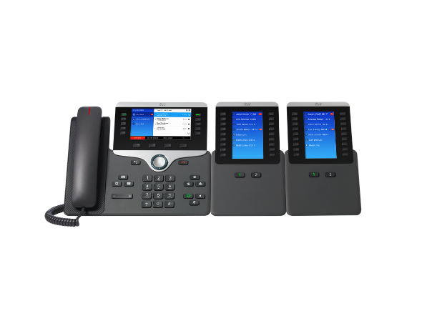
Multi-Line with Key Expansion Module
8851 IP Phone with Key Expansion Module
$24.13 per month
  Includes line, license, VM (if applicable) and device cost
5-button phone with 5” 800x480 color display with same standard features as other IP Phones
Up to 72 additional line or button appearances
USB charging port for smartphones
Superior voice quality with Full duplex speakerphone
A 2nd KEM 8800 can be added for an additional cost of $5.50 per month
Ideal for heavy call coverage areas, or administrative staff where you are sharing lines between staff and managers or handling calls for multiple people

Slide 7
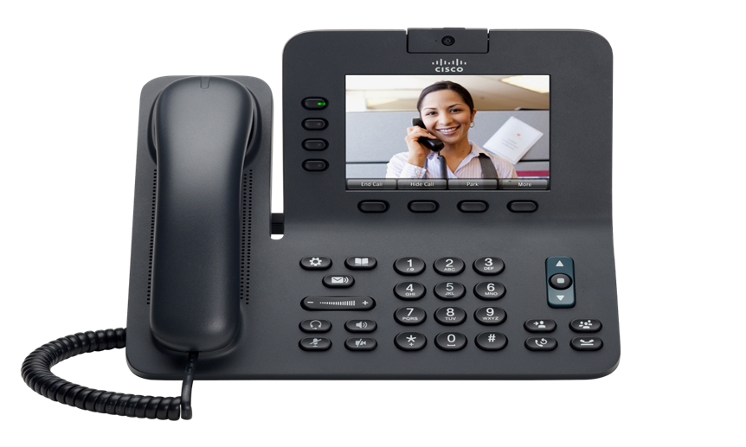
Video Phone
8945 IP Video Phone
$23.11 per month
  Includes line, license, VM (if applicable) and device cost
5” diagonal, VGA, backlit, anti-glare color display
4 programmable line and feature keys
High definition voice capability
Programmable soft-label keys and 4 fixed keys
Bluetooth for headset
Ideal for executives or managers who want to enhance point to point communications with others in their agency, using video

Slide 8
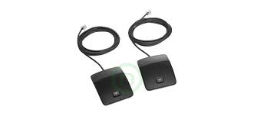
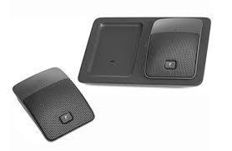
Conference Phone
8832IP Conference Phone
$26.90 per month
  Includes line, license, VM (if applicable) and device cost
Expanded room coverage
  2 units can be daisy chained together to achieve up to 1500’ sq ft of coverage
Superior hands-free wide-band audio
Wired control for host/chairperson
  1 speaker and 1 microphone come standard
Accessory options:
  Wired and Wireless extension microphone
Ideal for most conference rooms and executive suites where clear audio is desired and extended coverage is needed for conference calls

Slide 9
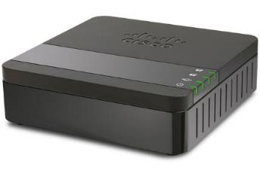
Analog Adapter
ATA 190 2-Port Analog Adapter
$2.58 per month
  Each port requires a line, license charge
2 Port analog device adapter, for fax or analog voice requirements
  Supports 2 simultaneous devices with 1 Ethernet (10/100 Base-T) port
Supports T.38 fax devices
Is easily placed within the same proximity of fax devices or in an IDF closet
Supports TLS security protocol
Requires external power (no PoE)
Ideal for most fax machines and faxing applications within an agency. A line ($9.91) and license ($4.15) charge is associated with each port of this device

Slide 10
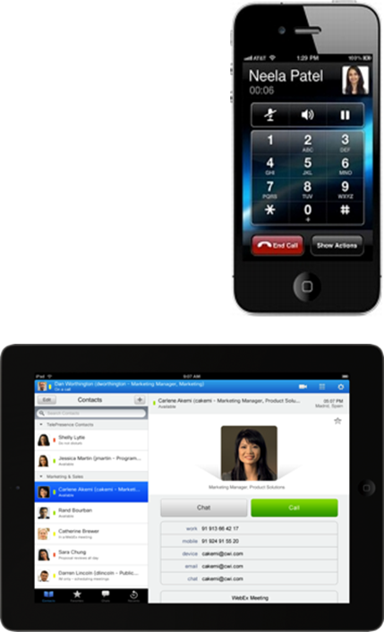

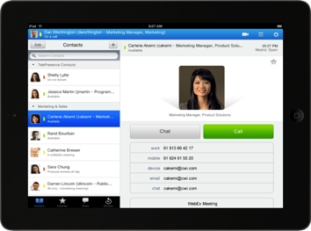

Jabber – No IP Desk Phone
PC, MAC & Smartphone and Tablet*
$16.06 per month (no desktop phone)
  Includes line, license, VM (if applicable) and Jabber cost
Jabber Desktop client for Windows or Mac
Provides presence (free/busy status) for contacts, and integrates to your Outlook Calendar
Instant Messaging – Chat, Group Chat, Desktop Share and File Transfer
Softphone with point-to-point video
Interactive list of voice messages
Click-to-call integration with all MS Office applications
Ideal for the mobile or teleworker that works from their PC/laptop from multiple places and is looking for advanced collaborative tools
*Note – Smartphone and tablet mobility support will be enhanced with future phase of infrastructure build out

Slide 11
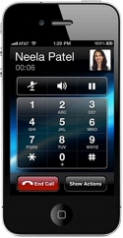
Jabber – Adding Mobility to a Desk Phone
Jabber for PC, MAC & Smartphone and Tablet*
$2.00 per month
  add-on cost to a desk phone
Smartphone or tablet client with advanced collaboration capabilities
  Visual voicemail for your Unity voicemail box
  Make/take calls on your smart phone or tablet from your desk phone number
Provides presence (free/busy status) for contacts,
Instant Messaging – Chat, Group Chat, Desktop Share and File Transfer
Softphone with point-to-point video
Ideal for the mobile or teleworker that works from their smartphone and/or tablet in conjunction with their desk phone, and wants advanced collaborative tools
*Note – Smartphone and tablet mobility will be enhanced with future phase of infrastructure build out

Slide 12

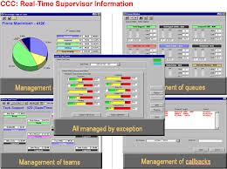
ACD – Enhanced Agent or Supervisor
ACD License for each agent/supervisor
$23.88 per month
  add-on cost to a desk phone
Provides efficient inbound call handling for a call center or customer service application
Accommodates at-home agent capability
Includes skills-based routing to expedite getting the caller to the right agent
Reporting is included to help manage call volume, and call handling efficiency
Accommodates alternative means for handling calls in peak or overflow conditions
Ideal for a high volume of similar type calls that come into an agency in a repetitive way, where reporting is required, i.e. customer service, helpdesk, etc…

Slide 13
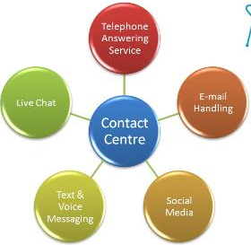

ACD – Premium Agent or Supervisor
ACD License for each agent/supervisor
$41.50 per month
  add-on cost to a desk phone
Same features as Enhanced, PLUS:
Screen Pops for IVR data for incoming calls
Inbound Email handling to the call center agent
Web Chat with a call center agent
Outbound Preview so agents can preview the call before getting connected
Ideal for the call center that is looking for advanced call handling and multi-media capabilities that will provide customers with alternatives for reaching an agent

Slide 14
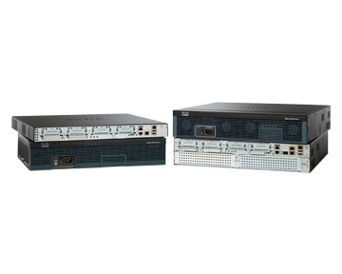
Agency Router
2911 Integrated Services Router (ISR)
Device price is configuration dependent & procured by agency
Survivable Remote Telephony Services
  Provides basic outbound and internal calling in the event that there is a WAN failure
  Requires additional trunking to the PSTN
Supports PSTN (analog and PRI) interfaces
Supports analog voice interface
Supports off-net calls to 911
Ideal for the agency that needs to have a tertiary level of redundancy at the building level for inter-office and outbound calling

Slide 15
End Point Cost Summary
 | End Point | Model # | Cost/Mo. | Comments
A | Lobby | 3905 | $14.98 | Single line IP phone, equivalent to legacy 2500 set
B | 2-Line | 8811 | $17.75 | Most common desktop choice for IP phone
C | 5-Line | 8841 | $18.68 | Common management or executive desk phone
D | Multi-Line w/KEM | 8851/KEM | $24.13 | 5-Line with the ability to add’l keys via expansion module
E | Video | 8945 | $23.11 | Point-to-point video conferencing capability
F | Conference | 8832 | $26.90 | Full duplex IP speakerphone
G | Jabber w/o Phone | N/A | $16.06 | Softphone or mobility for PC/MAC/Android/IOS devices
H | Analog Adapter | UC 2-Port | $2.58 | Converts 1 Ethernet port into 2 analog ports (fax, modem)
Below are the add-on capabilities for additional functionality
I | Jabber | N/A | 2.00 | This adds softphone and mobility to a desk phone user
J | ACD Enhanced | N/A | $23.88 | This adds Enhanced ACD licensing to a desk phone user
K | ACD Premium | N/A | 41.50 | This adds Premium ACD licensing to a desk phone user
L | Key Exp Module | KEM 8800 | $5.50 | This adds a 2nd KEM to be to an existing 8851
M | Router | 2911 | TBD | Cost is configuration and design dependent
A – G are inclusive of line, license, VM (if applicable) and device costs
H – Each port on the Analog Adapter requires $9.91 line charge and $4.15 license charge

